Slide 1
PaceSetter Hacklahoma ‘26
Kegan Reynolds, Logan Tanner, Ian Sendelbach

Slide 2
What Our Hack is
PaceSetter is a wearable device that uses machine learning to predict your pace, energy spent, and fatigue level based on your personal metrics and the trail statistics. You can either enter the distance and elevation manually or drop 2 GPS pins and fetch the route and elevation profile using OpenRouteAPI.
Our local hosted website will take your target pace and relay this to the wearable device. If you go too far below or above the target pace, a servo (connected to a XIAO-ESP-C3 on your wrist with a GPS attachment) will vibrate, the speed of which indicates whether you need to speed up or slow down.

Slide 3
How We Built It
Initially built out basics of web interface and functions that ML model would later learn from
Integrated web & Python using Flask extension to host server that runs necessary calculations
Simulated 100k hikes using different distribution functions, took that data and trained 3 ML models – one for pace, calories burnt, and fatigue level
Arduino connects to Python via USB-C to store target pace
Arduino uses GPS to display pace and total distance
Servo goes off if speed is detected to be outside of 10%

Slide 4
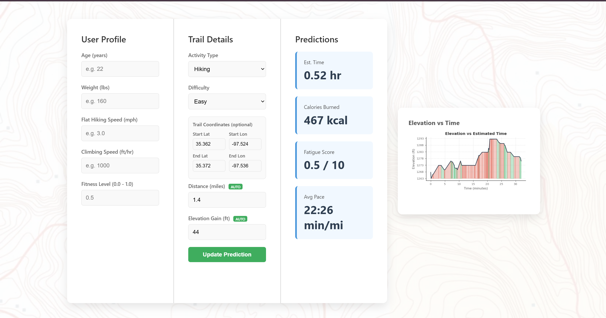
Web Interface
Place to input all user data such as age, weight, etc.
Able to input coordinates and OpenRouteAPI extracts the elevation profile and distance data
OpenRouteAPI also allows for an elevation map along your hike/run
The calculations to get the outputs are done through Python scripts on a server hosted through Flask

Slide 5
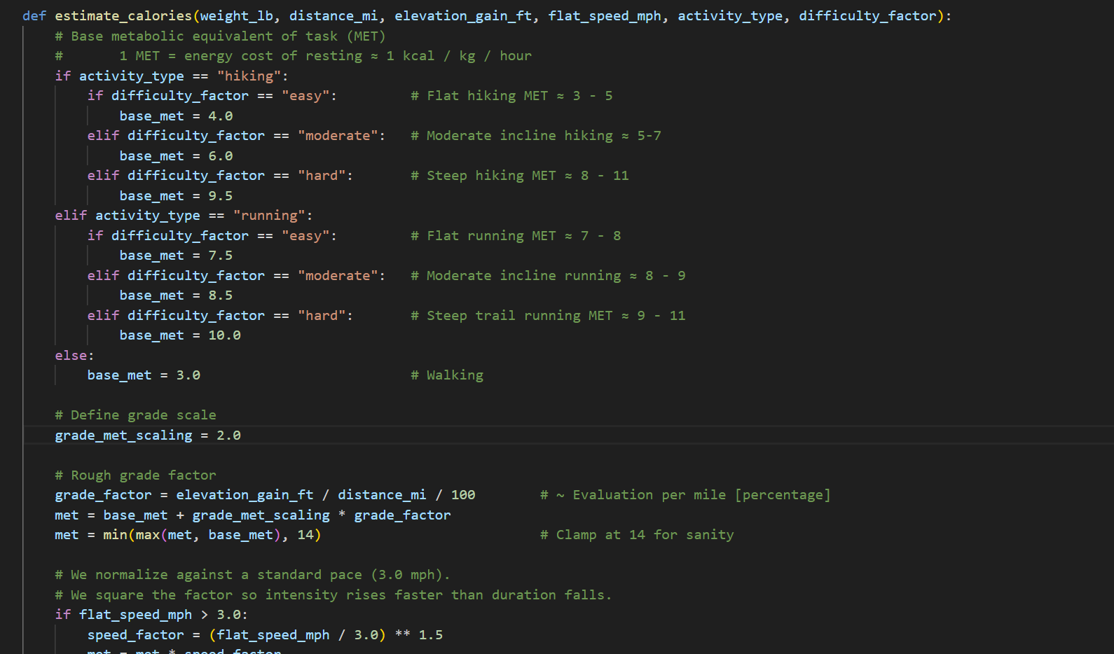
Python Engine
Kegan wrote the initial Python scripts to get the data to train our ML models on
Got initial values through arithmetic involving the user’s stats along with the trail’s stats
Extremely lightweight so the ML process didn’t take too long

Slide 6
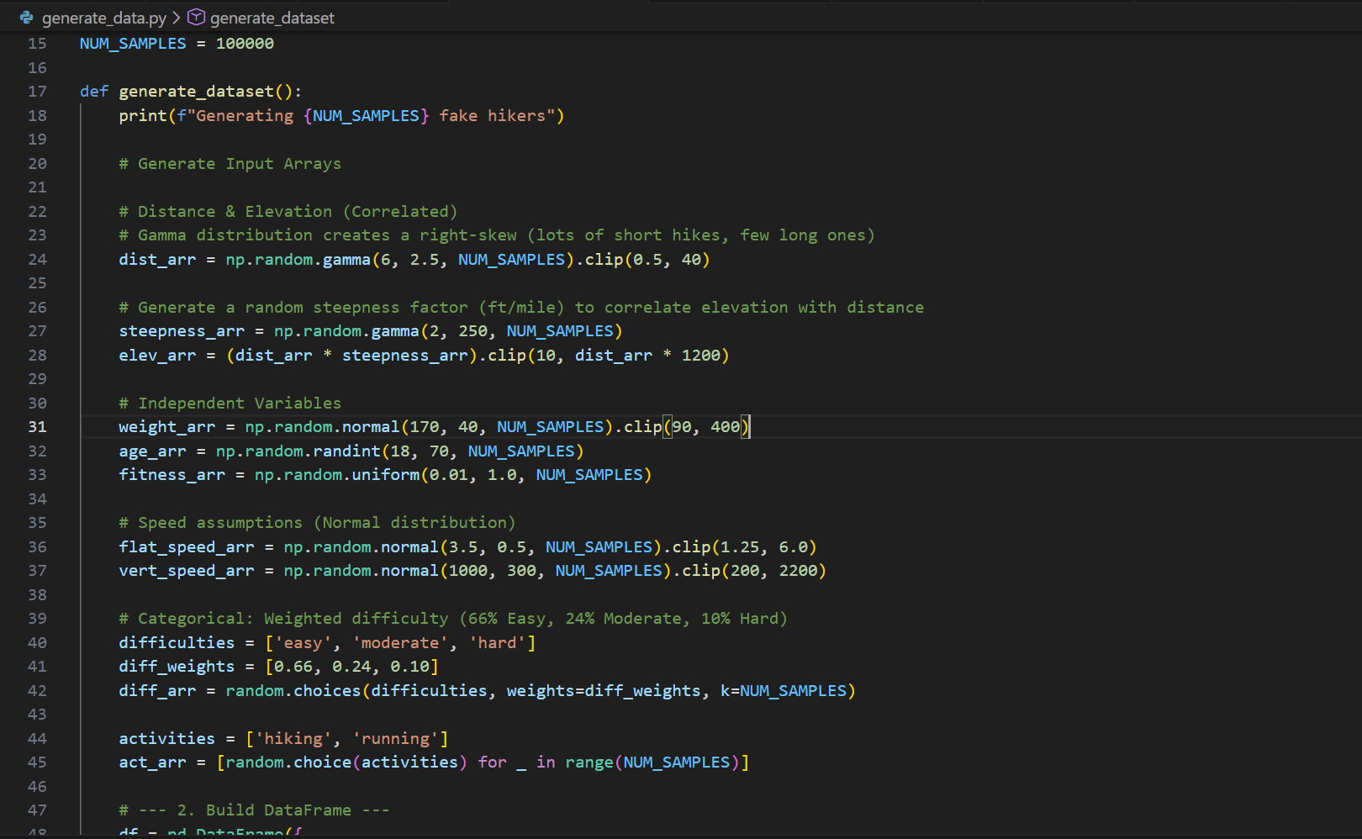
Machine Learning (ML)
Simulated 100k hikes using random/gamma distributions of inputs
This approach allowed for our model to get an idea of what the results should look like while still allowing for outliers
Once we had our 100k hikes, we used scikit to train our models on that data
Utilized clamping data as to avoid extreme/impossible outlier cases

Slide 7
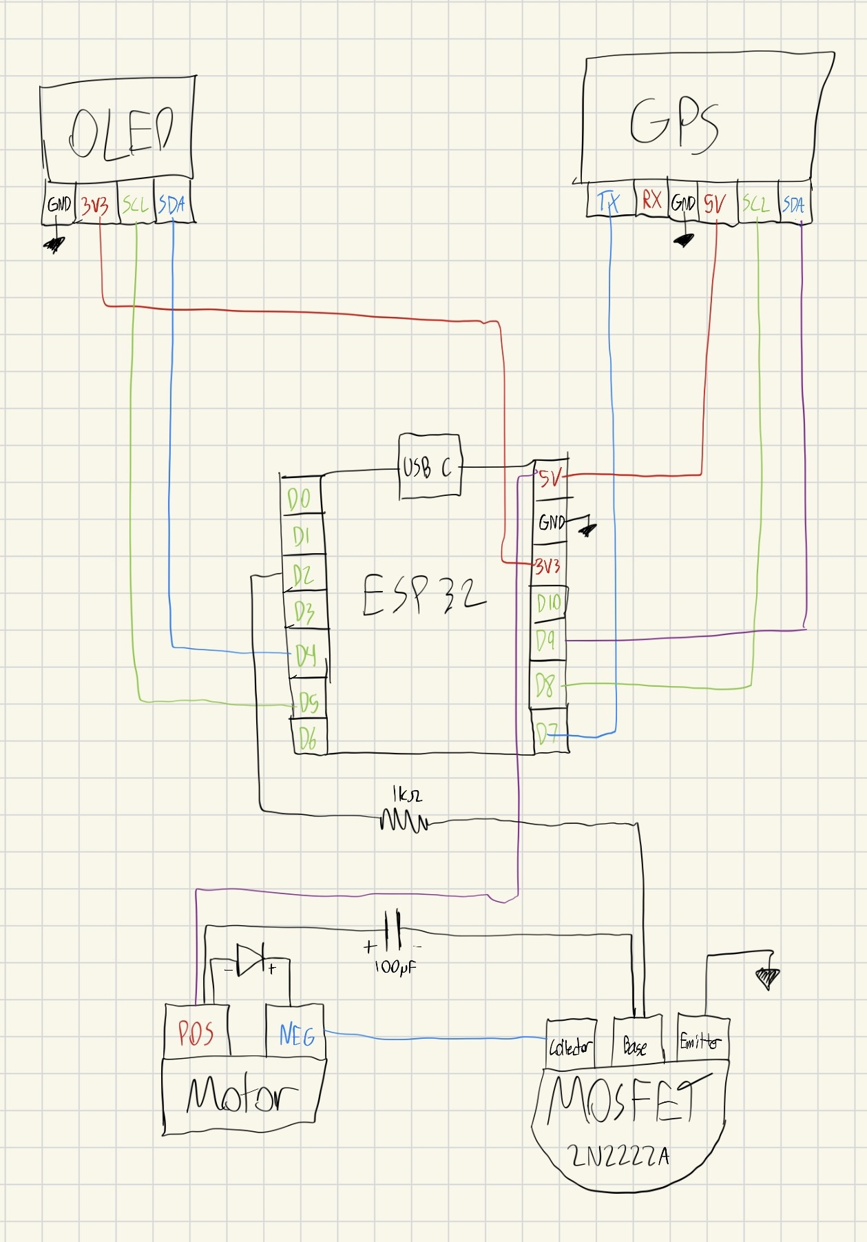
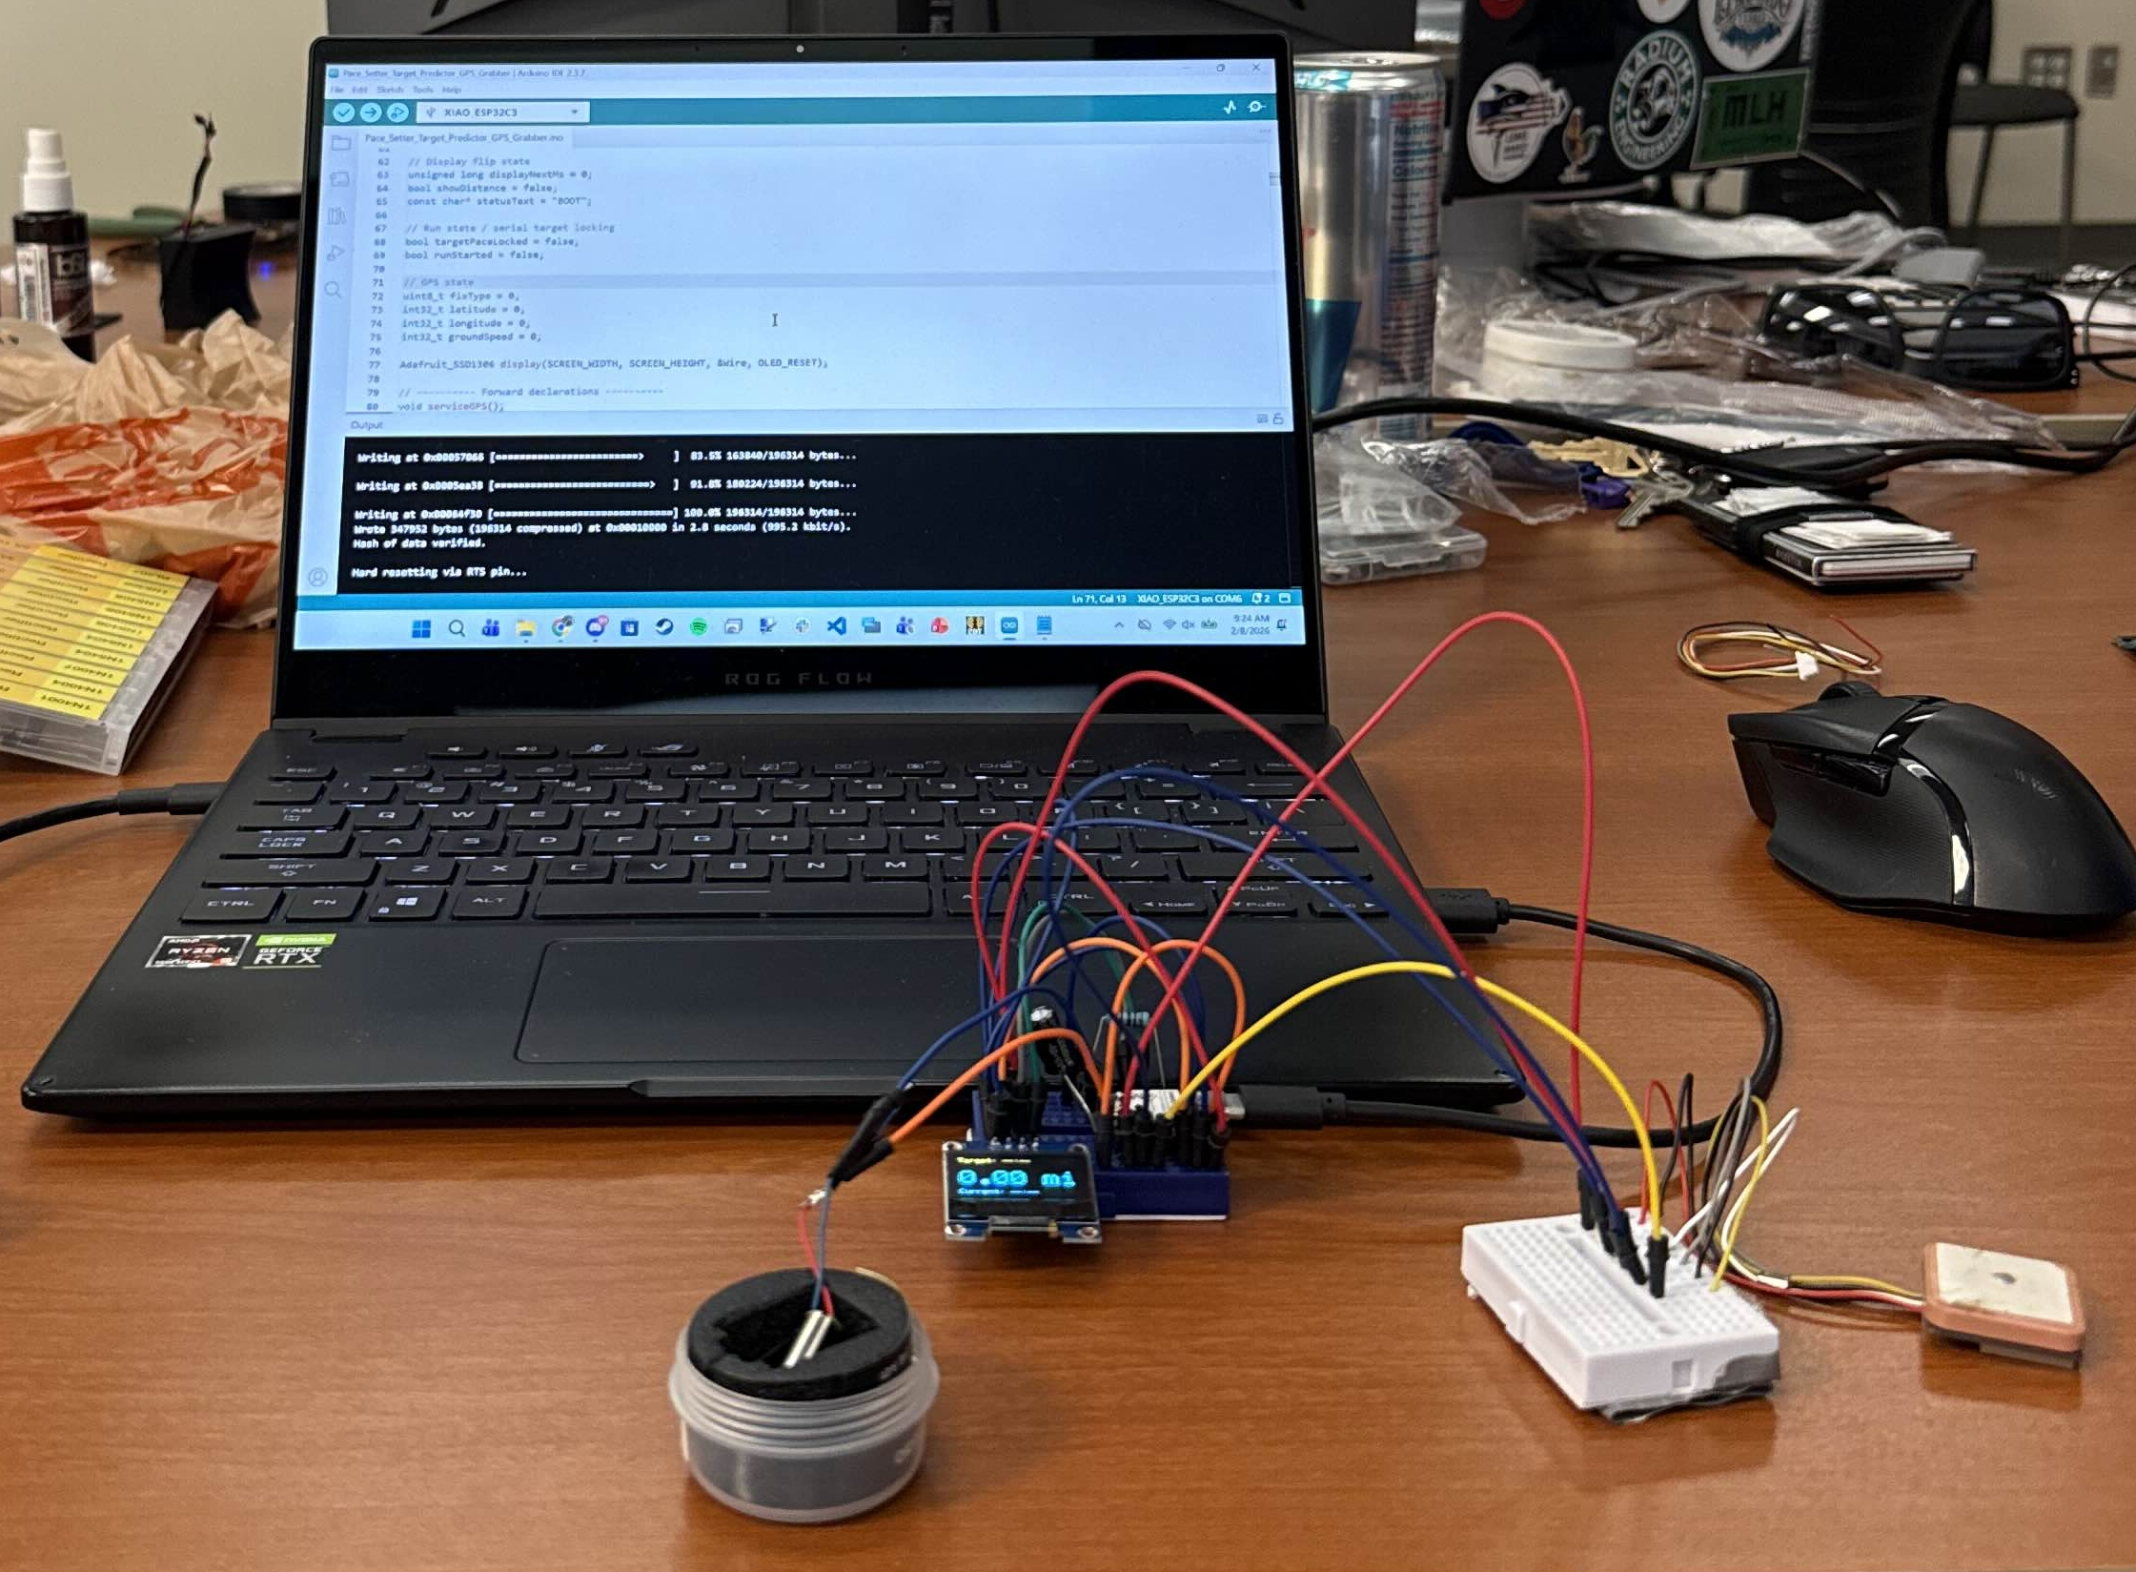
Hardware
XIAO-ESP-C3 is first connected via USB to laptop to get the target pace based on user parameters
Then the code begins the run or hike.
If the user has fallen outside of a preset tolerance of the target pace, a DC motor vibrates accordingly

